Slide 1
A New Magnet R&D Approach and Test Facility for High Field Magnets
R. Gupta, K. Amm, M. Anerella, J. Cozzolino, P. Joshi, S. Joshi, S. Plate, W. Sampson and P. Wanderer
Brookhaven National Laboratory, Upton, NY 11973 USA
September 25, 2019

Slide 2
OVERVIEW
A new approach to magnet R&D
      Rapid-turn-around, lower-cost R&D to test innovative ideas and to perform systematic studies
A unique test facility dipole
Past, current and future programs
      Current program: HTS/LTS hybrid dipole
Future plans for enhancing the test facility

Slide 3
Magnet R&D Approach
Conventional development of a new technology requires building and testing one or a series of R&D magnets
Examples:
  New conductors
  Coils made with new cables
  New insulations
  New epoxies
  New coil designs
Building and testing, however, takes several years and a significant budget
  NOT building and testing coils near the desired field level increases the risk, particularly for the high field magnets
This reality has shaped our thinking

Slide 4
Limitations on Technology Development
If it takes several years and a significant budget, it puts pressure on the magnet program to demonstrate a success
That discourages us from deviating significantly from those “that sort of works” and limits optimizing of a “sort of working technology”
It limits the development of a new technology “unless one has to”
On the other hand if a magnet doesn’t work, we tend to change several things at a time. Then if the magnet starts working, it becomes difficult to distinguish what made it work => incorporate all changes?
In summary, the cost and time needed to demonstrate a new technology at high fields has limited the development of new technologies and also optimization of the existing ones
A comprehensive magnet development program ought to develop strategies to overcome above inherent limitations

Slide 5
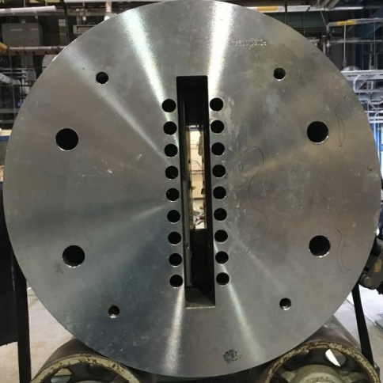
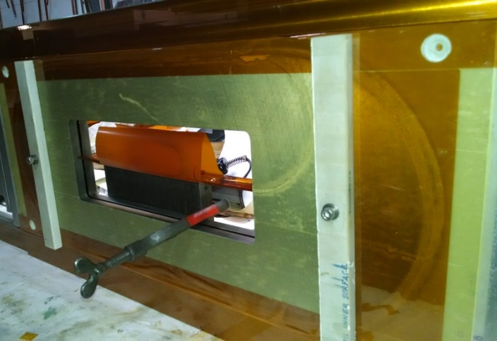
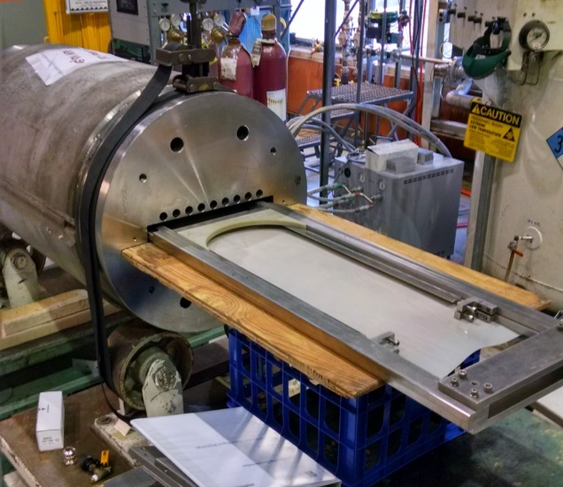
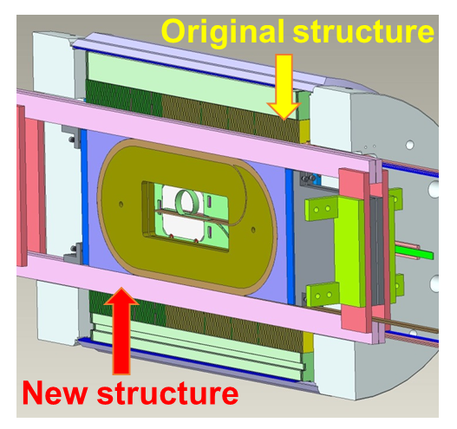
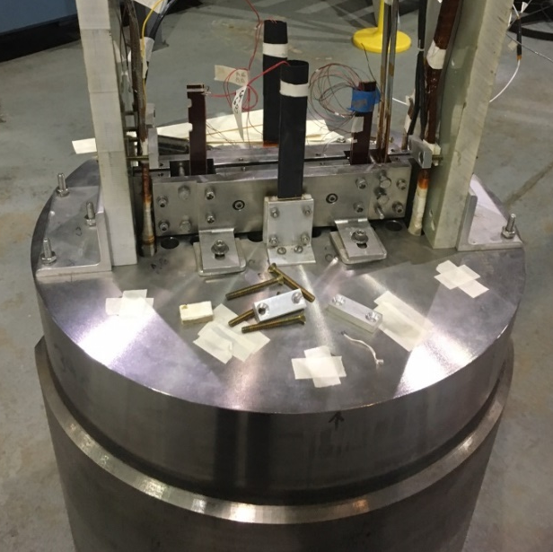
New R&D Approach Concept
(rapid turn-around, low cost)
Magnet (dipole) with a large open space
Coil for high field testing
Slide coil in the magnet
Coils become an integral part of the magnet
Magnet with new coil(s) ready for testing
Five Simple Steps/Components
1
2
Empty space
3
4
5
Insert coils in Empty space

Slide 6
Guiding Principle of the R&D Approach
GUIDING PRINCIPLES
A test vehicle where new coils can be tested in a short period of time (a few months) and in a reasonable budget (few hundred k$)
Tests are performed at a significant field (potentially up to 16+ T on coils) making them relevant for the high field magnet technology
New coils become an integral part of the magnet so that a new coil test can be considered as an R&D test of the new magnet technology
OUTCOME:
If above works, it changes our thinking on how to plan magnet R&D
It will allow us to be more enterprising since a potential setback will be failure of a coil, not failure of a magnet (less dramatic)
Moreover, rapid-turn-around will allow systematic studies

Slide 7
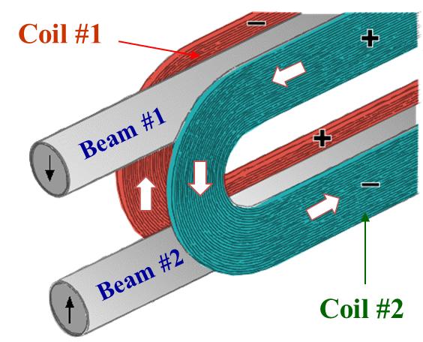
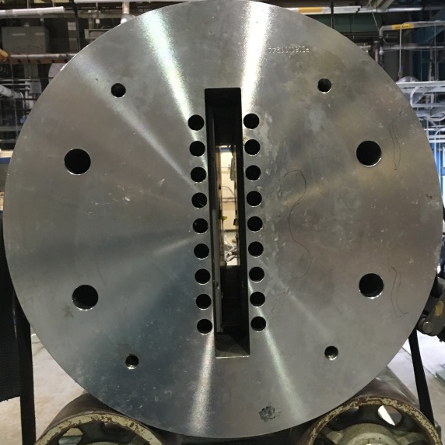
A Unique Background-field Dipole
Nb₃Sn, 2-in-1, common coil dipole
Structure specifically designed to provide a large open space (31mm wide, 335mm high)
New racetrack coils can be inserted here for testing them in a background field of ~10 T
These new insert coils come in direct contact with the existing Nb₃Sn coils and become an integral part of a potential 16+ T magnet
A new coil test becomes a new magnet test
A rapid-turn around and low-cost test
Empty space

Slide 8
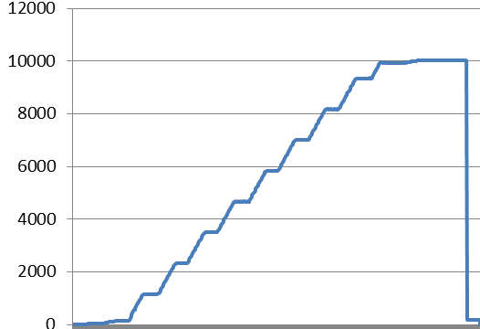
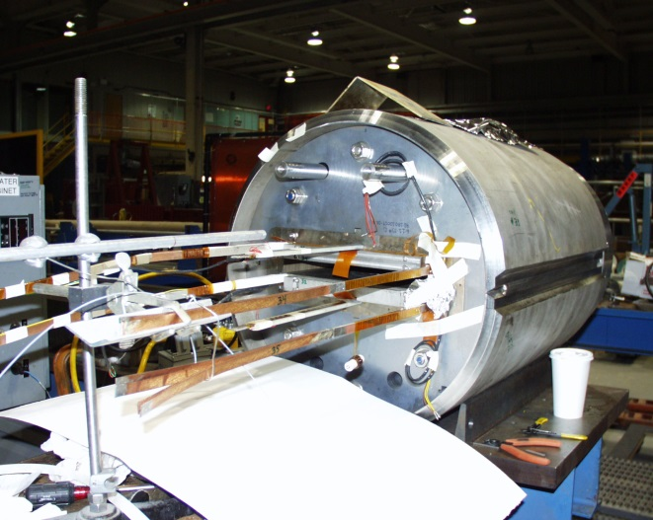
BNL Common Coil Dipole DCC017
A Robust Magnet for Test Facility
Short Sample: 10.8 kA (reached during 2006 test)
Retest (2016): No quench to 10 kA (>92% of SS)
Worked well when tested after a decade
~9.5T@10kA
Current (A)
It was a display piece of Nb₃Sn “React & Wind” technology for dipole

Slide 9
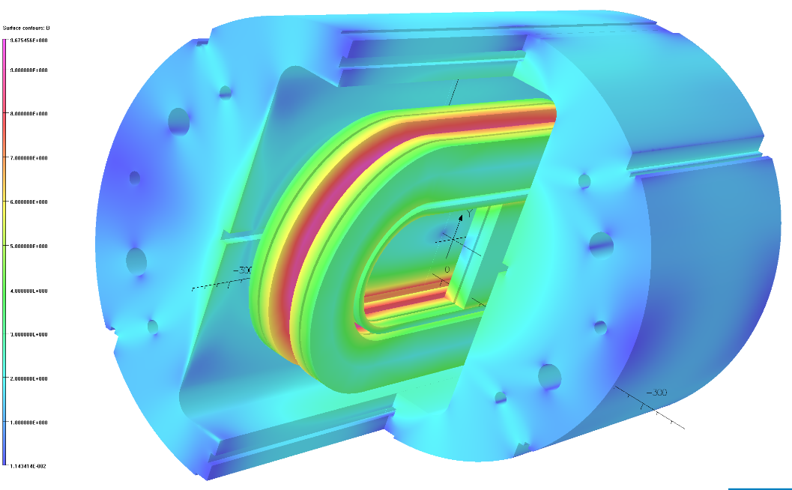
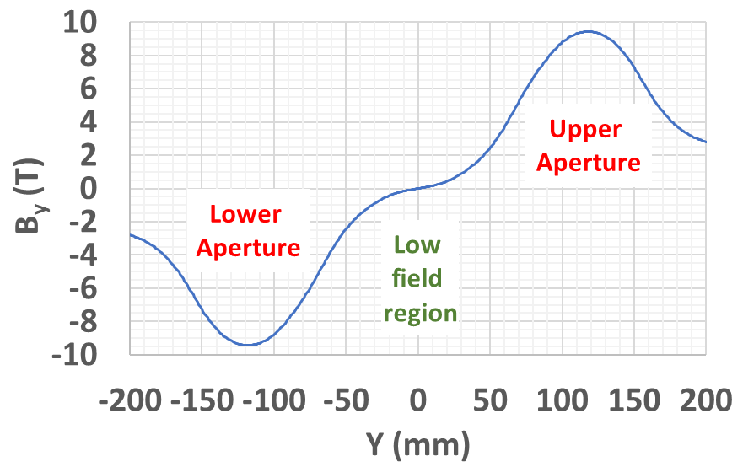
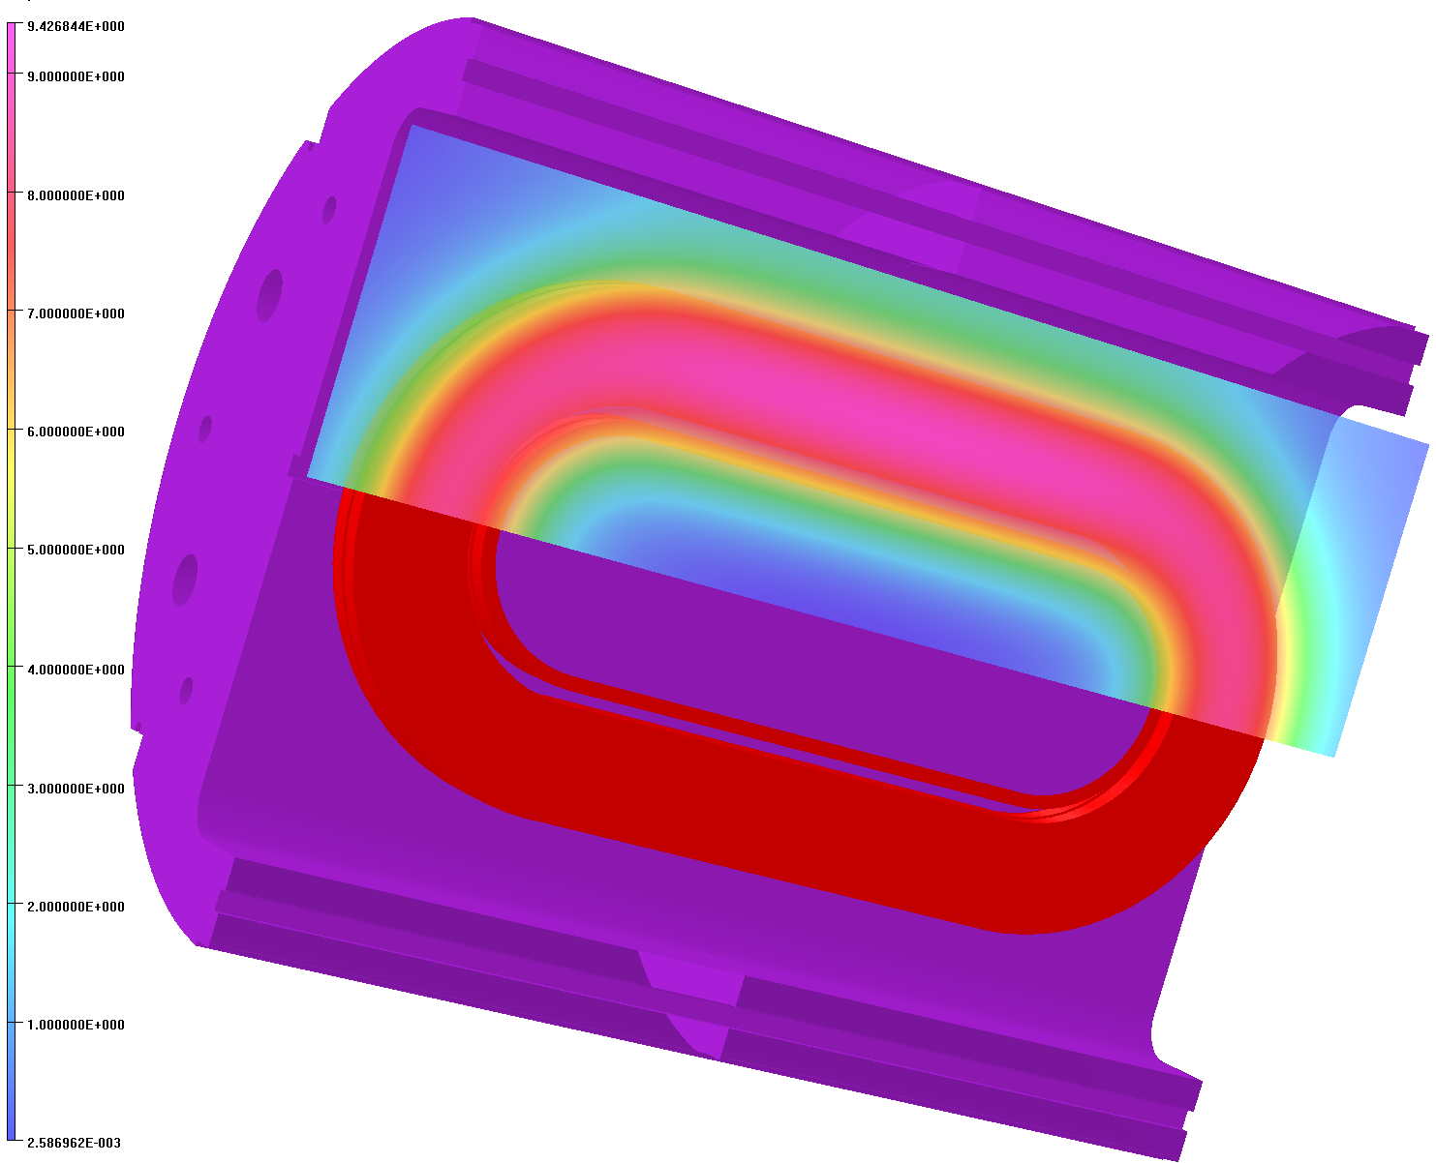
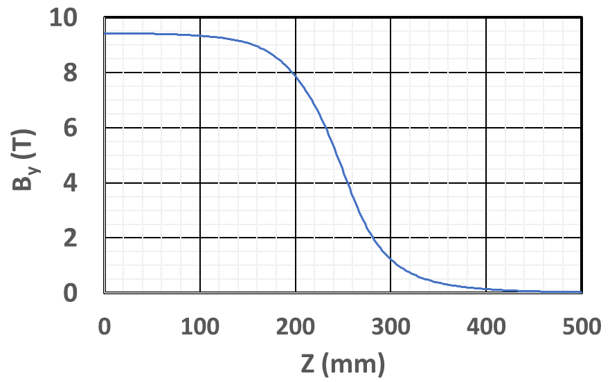
Magnetic Fields at 10 kA
Field superimposed over iron and coil
B_{y} along vertical axis
9.7 T
9.4 T
Place for insert coil
B_{y} along z-axis
Field @ x-z plane
Low field region

Slide 10
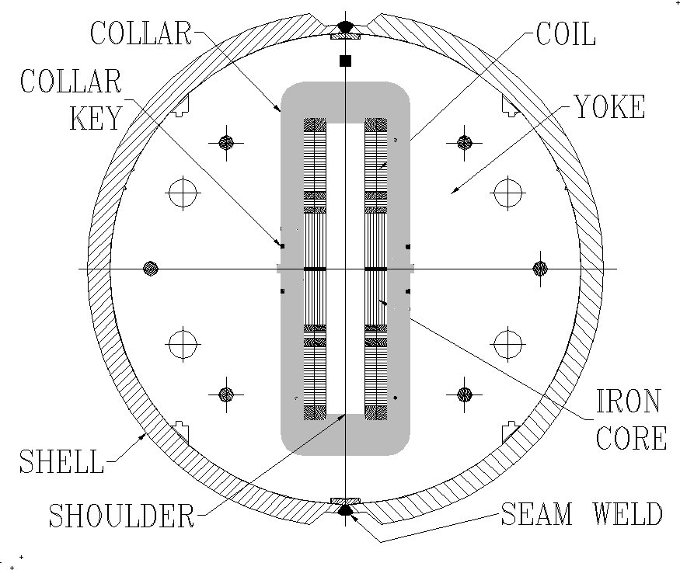
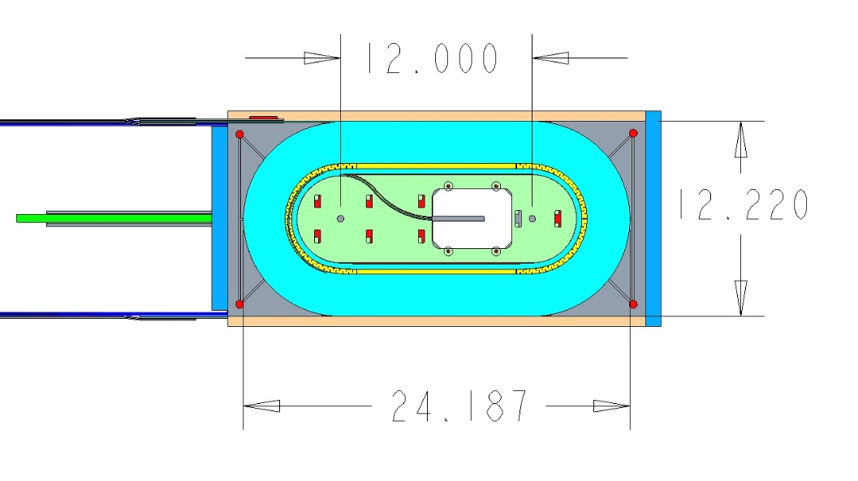
Main Parameters of DCC017
31 mm
Nb₃Sn, R&W, dual aperture dipole
Short sample current: 10.8 kA
Maximum current reached: 10.8 kA
Bore field: 10.2 T
Peak field: 10.7 T
Horizontal opening: 31 mm
Vertical opening: 335 mm
Coil height in each aperture: 85 mm
Straight section: 305 mm
Coil length: 614 mm
Center-to-center btw 2 aperture: 118 mm
Stored Energy @ Quench: ~0.2 MJ
Inductance: 4.9 mH
335 mm
304.8 mm
310.4 mm
614.3 mm

Slide 11
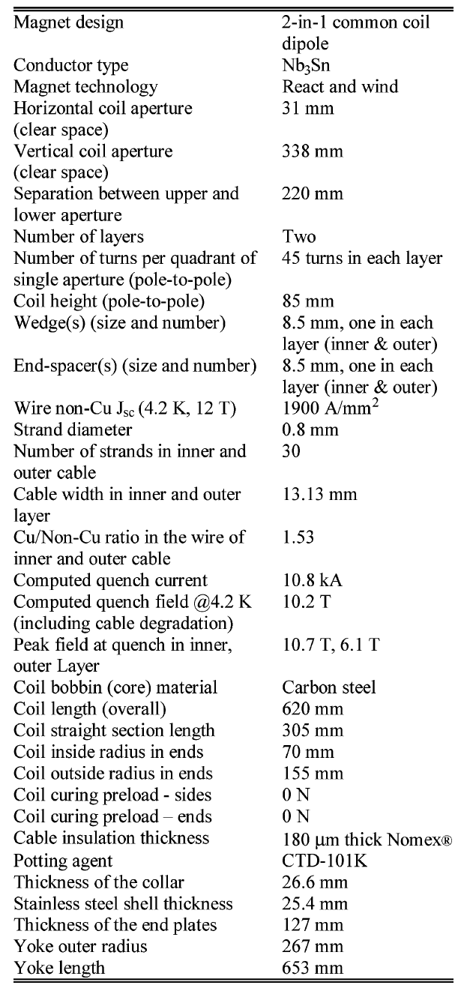
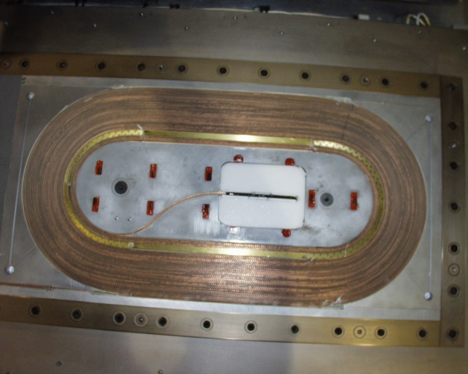
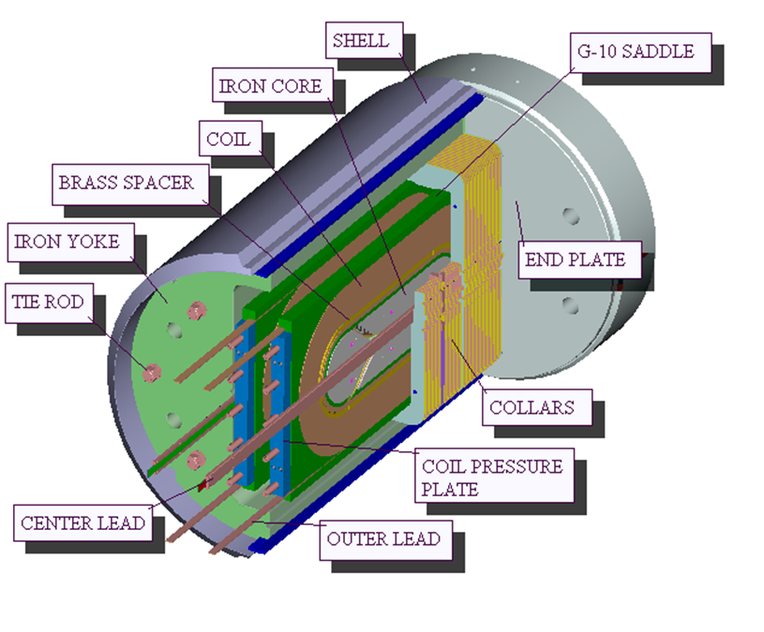
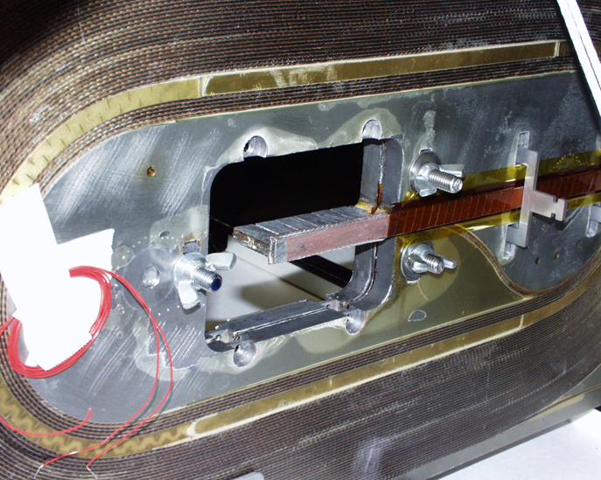
Details of the Magnet DCC017
(React & Wind Dipole with Low Pre-stress)

Slide 12
Benefits of the Rectangular Opening in Common Coil Structure
Rectangular opening has several inherent advantages:
It provides a flexible structure to allow a different number of insert coils. These coils can have different height/width and their relative position can be changed, as long as they fit in the opening
  One generally doesn’t have similar flexibilities in a cosine theta magnet with circular bore
These coils can be made of different materials
The same opening can be used to test cables - even those cables that can’t be bent in small radius
  Furthermore, these cables can be looped for a longer length cable test in a high field region

Slide 13
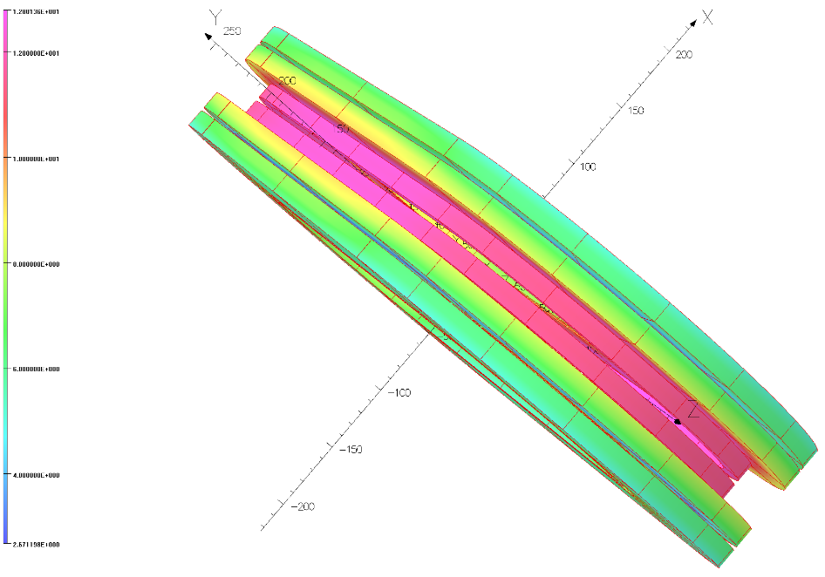
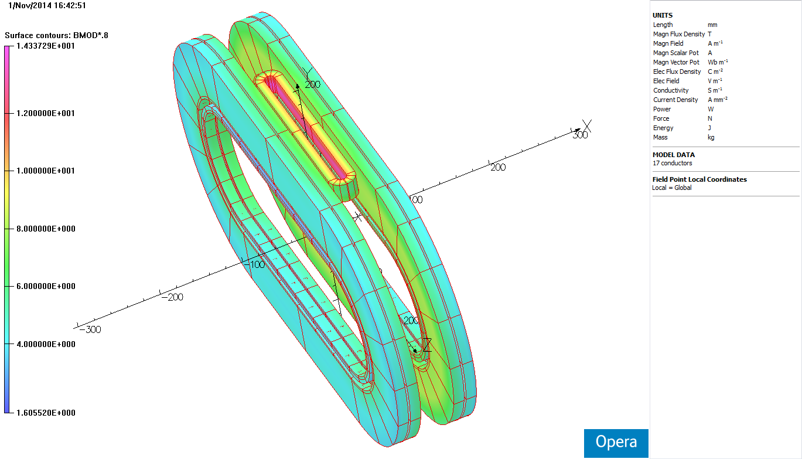
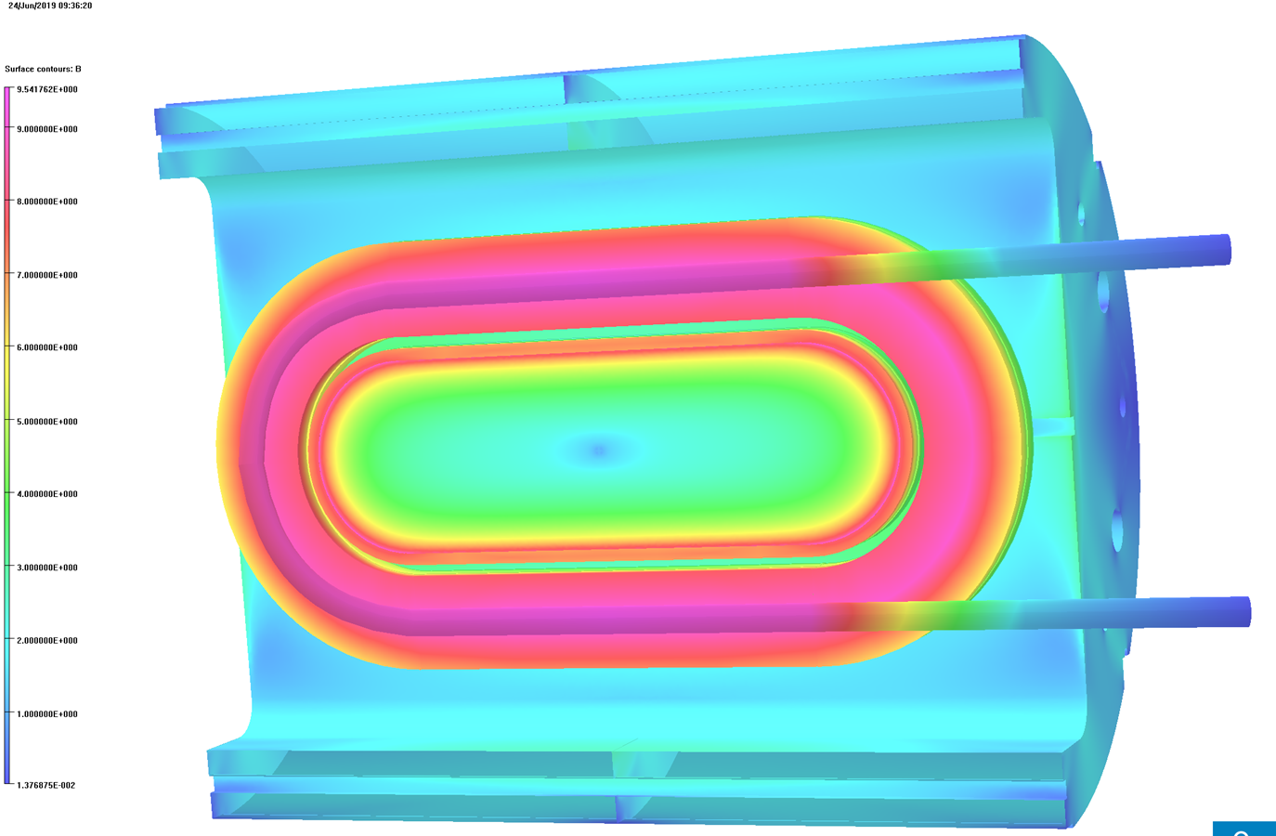
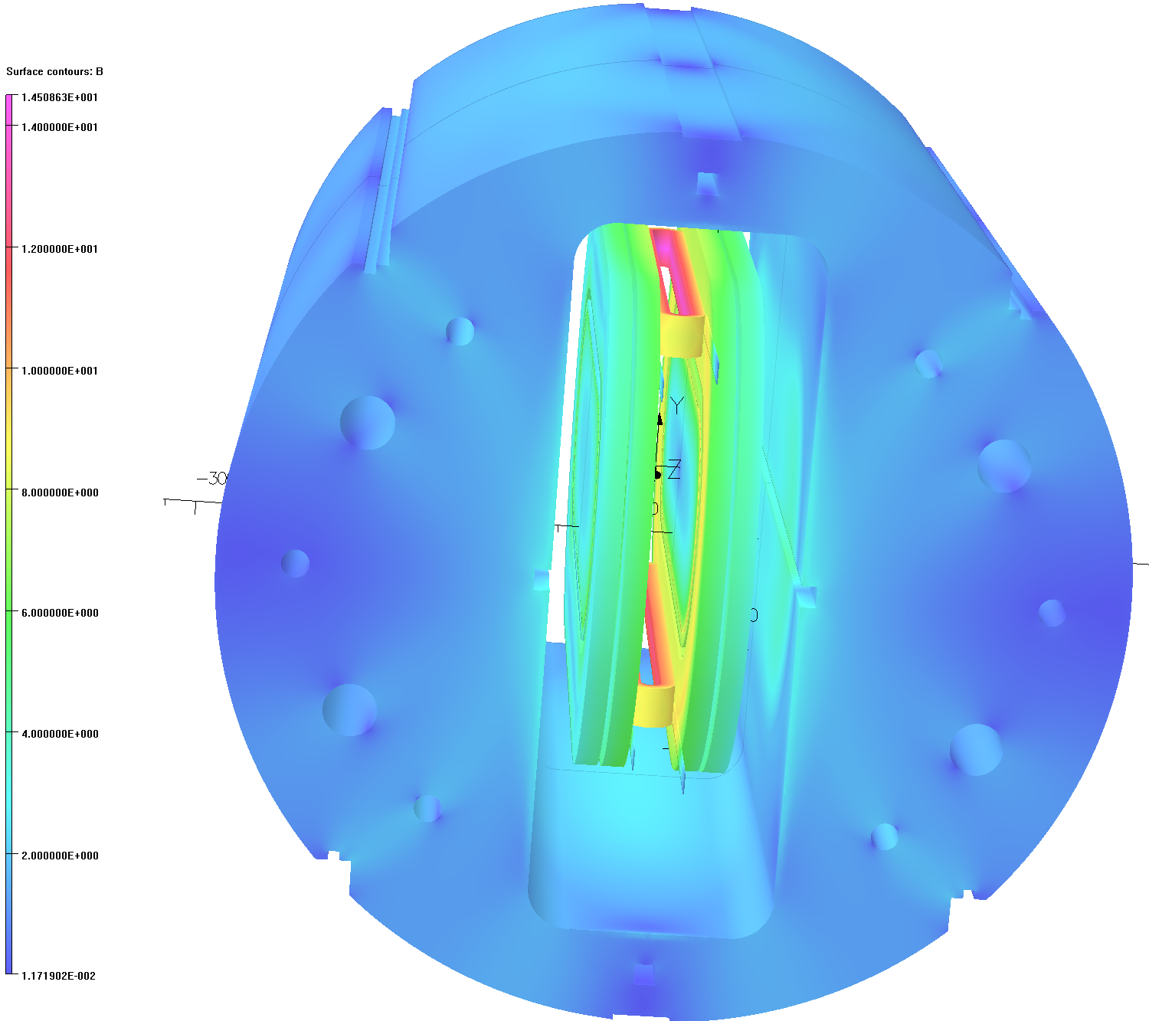
Four Possible Configurations for Insert Coils and the Cable Tests
Standard insert coil test configuration
One insert coil in one aperture
2
1
4
3
Two independent insert coils in two aperture
Cable test configuration

Slide 14
Key steps and Considerations

Slide 15

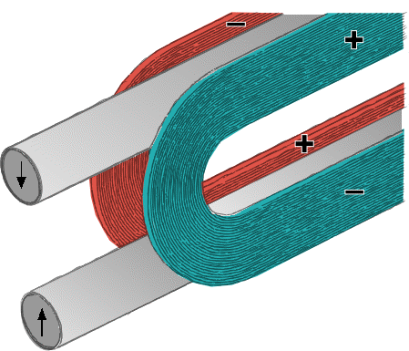
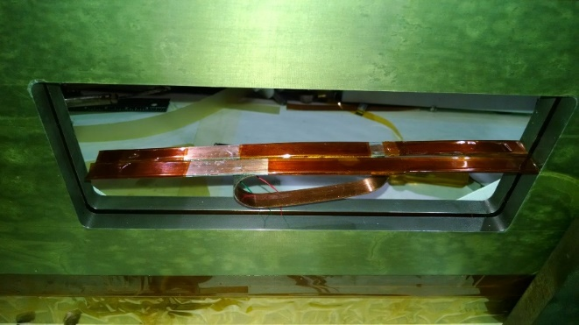
Making Insert Coils an Integral Part of the Magnet
Insert a pair of new coils in the opening. There has to be some tolerances
These coils move apart under Lorentz forces and make contact with the existing magnet coils. This makes the insert coils an integral part of the magnet
A flexible splice between two coils has been developed which allows this motion. It stays in the low field region of the common coil
The insert coils can be operated with an independent power supply or in series with the main magnet coils
A flexible splice

Slide 16
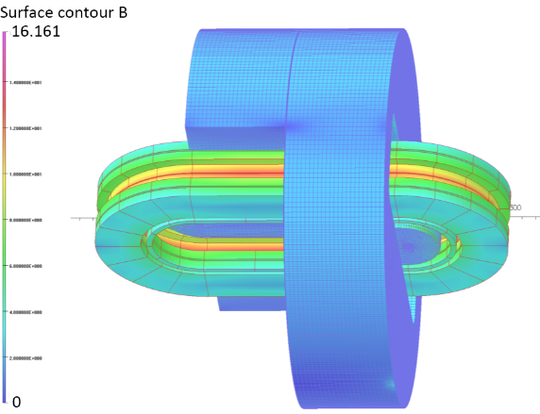
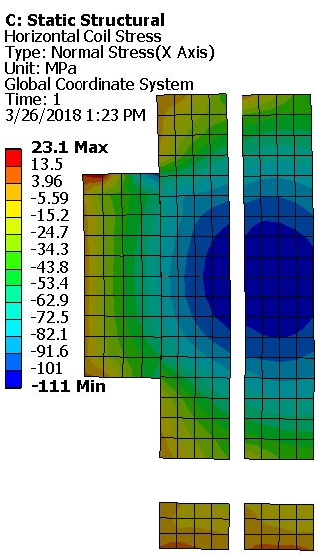
Capability of Magnet Structure
Structure of DCC017 is designed to deal with much higher loads than that of Nb₃Sn coils only
The additional forces from the insert coils cause additional deflections on the support structure and additional stress/strain on the NB₃Sn coils
Calculations show that the DCC017 structure may accommodate a field of 16 T generated by the combination of the insert coil and the Nb₃Sn coils
Computed stress and strain on the Nb₃Sn coils remain within acceptable limit
Insert coil
Nb₃Sn coil
Nb₃Sn coil

Slide 17
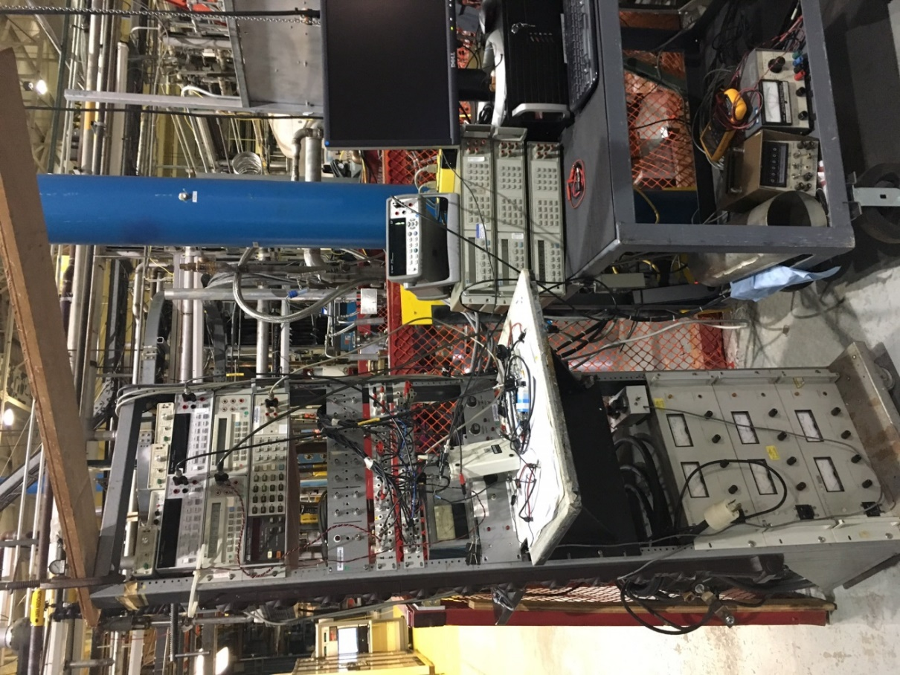
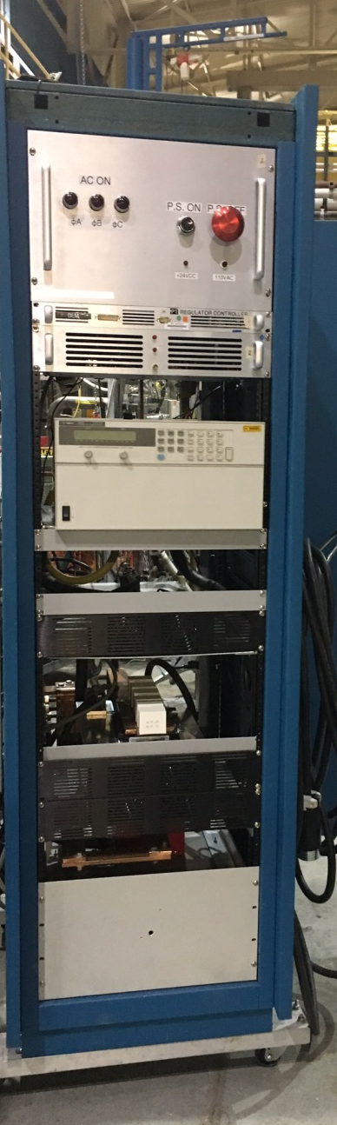
Quench Protection
Quench protection system is designed to protect both the main magnet coils and the insert coils
The insert coil may be HTS or LTS
BNL advanced quench protection with fast energy extraction has protected both HTS and LTS coils
The impact of inter-coil coupling (specially in the event of quench) is an important consideration

Slide 18
Projects Using New R&D Approach and Test Facility at BNL
Experience with the successfully completed project
  HTS/LTS hybrid dipole (funded by an SBIR/STTR)
Current project underway with a significant progress
  HTS/LTS hybrid dipole (funded by the Magnet Development Program or MDP)
Projects already funded with some progress
  CORC coil magnet with HTS and LTS cable coils running in series (funded by SBIR/STTR)
  CORC cable quench studies in a short coil (funded by the MDP)
Proposals (not yet funded)
  Quench studies in twisted-stack-cable (may be funded by INFUSE)
  HTS/LTS hybrid dipole (may be funded by US/Japan collaboration)
  Bi2212/Nb₃Sn hybrid dipole (LBL/BNL collaboration to be funded by MDP)
  Texas A&M high current cable test (may be funded by MDP or INFUSE)

Slide 19
First Demonstration of DCC017 to Carry out New R&D Approach
Design, build and test a respectable field HTS/LTS hybrid dipole for PBL with the budget of an SBIR
  Insert coil made with the HTS tape
  Assure quench protection
  Perform magnetization measurements

Slide 20
SBIR to Demonstrate a Significant Field HTS/LTS Hybrid Dipole
SBIR have a limited budget and limited time scale
So it has to be a low-cost, rapid-turn-around Program
SBIR with Particle Beam Lasers, Inc. (PBL) to design, build and test a respectable field HTS/LTS hybrid dipole
  Wind HTS coils with the ReBCO tape
  Integrate a pair of HTS coils with Nb3Sn dipole DCC017
  Assure quench protection
  Perform magnetization measurements

Slide 21
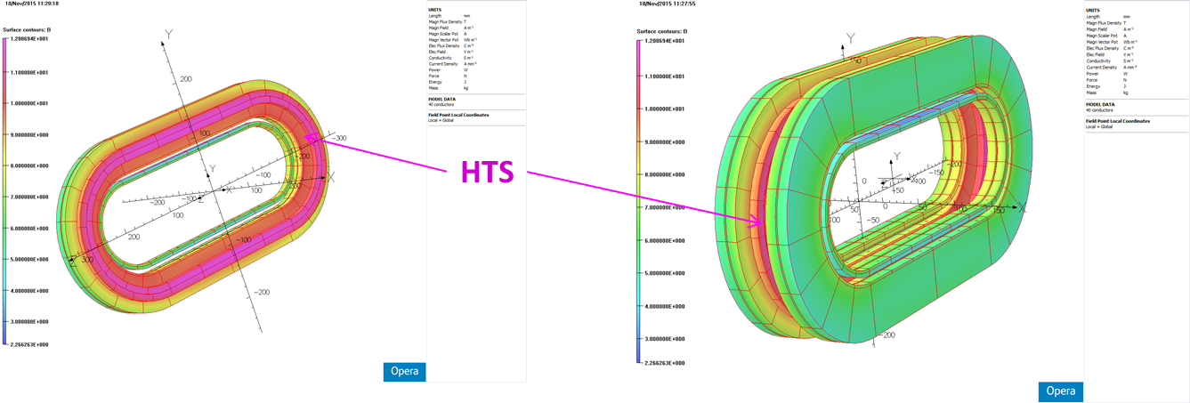
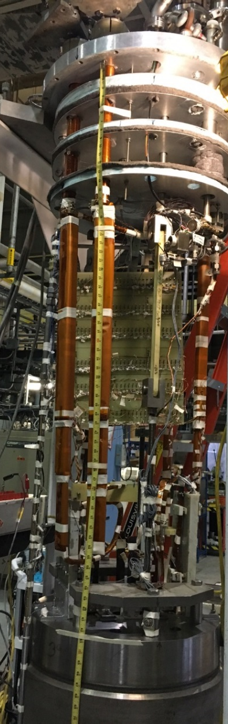


HTS/LTS Hybrid Dipole
(field on HTS coils primarily perpendicular)
Insert coils in Empty space

Slide 22
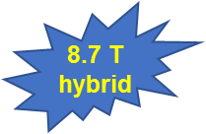
HTS/LTS Hybrid Dipole Test Results
(new HTS insert coils with existing Nb₃Sn magnet coil)
Encouraging Results:
HTS coils were ramped to quench, just like LTS coils
HTS coils had no training, no degradation despite a number of quenches
Field error studies with wide face of the HTS tape aligned primarily perpendicular to field
Quench Studies
Reported at MT25

Slide 23
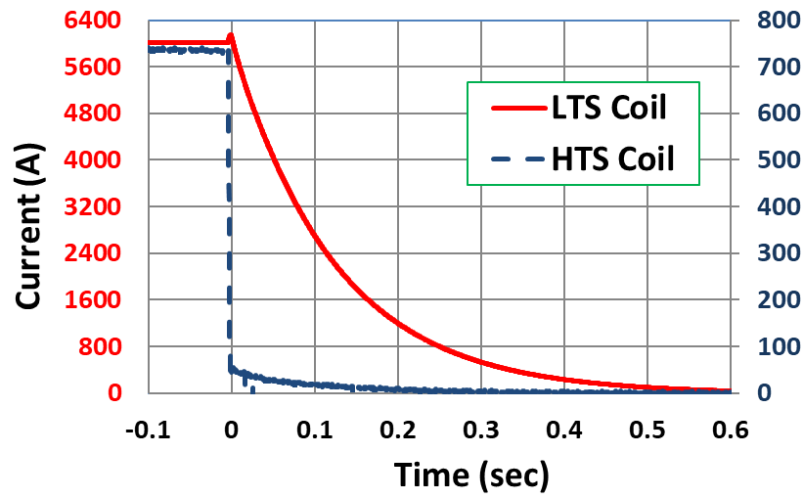
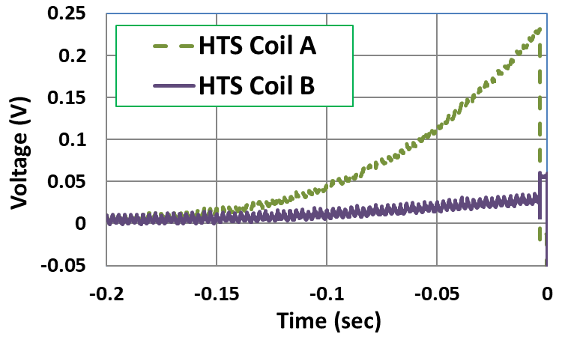
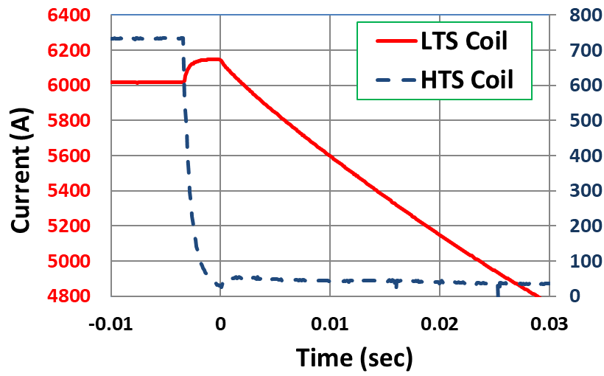
Quench Protection of HTS Coils in HTS/LTS Hybrid Magnet
HTS coils operated like HTS coils
Significant voltage in HTS coils
HTS and LTS coils were operated with different power supplies and had separate energy extraction under a common platform
Coupling between HTS & LTS

Slide 24
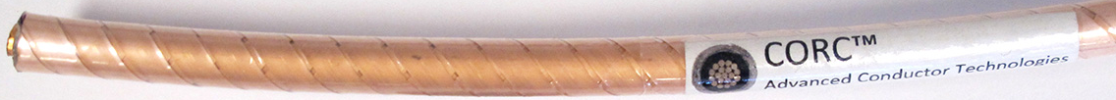
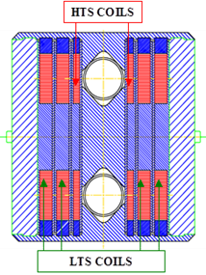
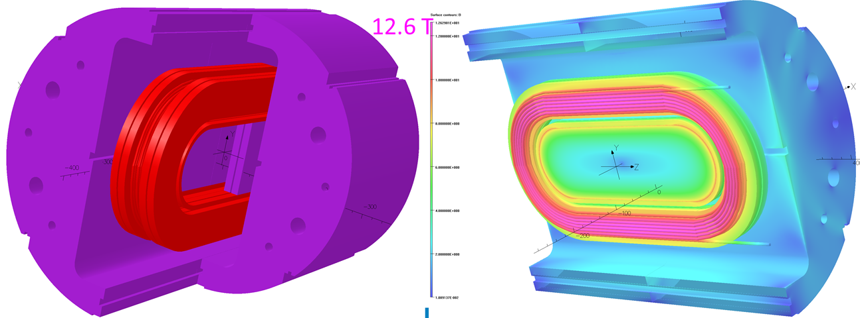
Second Funded Project Using DCC017
(Phase II STTR with Advanced Conductor Technologies LLC)
Coils made with high current CORC® cable inserted in DCC017 to “operate in series with Nb₃Sn coils” (it has many advantages)
Courtesy: Danko van der Laan
Common coil design accommodates high current CORC cable with large bend diameter in racetrack coil geometry

Slide 25
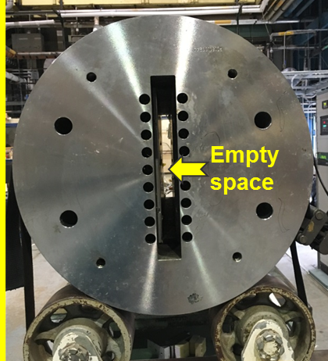
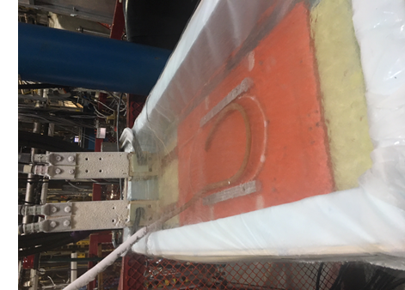
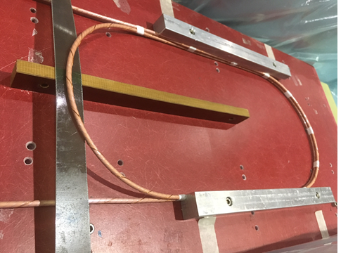
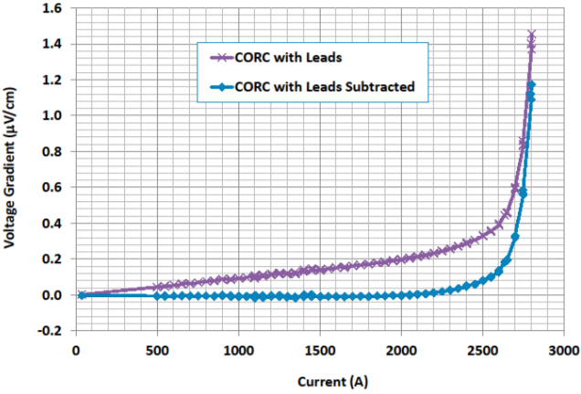
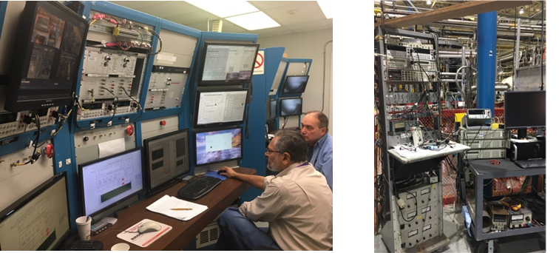
Test of High Current CORC®
_{Dipole DCC017}
Cable bent and lifted (as per the design of DCC017)
High current test in LN₂
No degradation from quenches at ~2.8 kA
(need to protect up to 10 kA at 4 K)
Advanced control and quench protection system

Slide 26
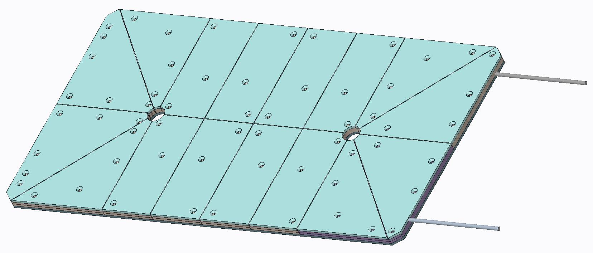
A Possible Structure of CORC Coil Module that can be inserted in DCC017

Slide 27
Third Funded Program
(getting ready for testing)
HTS/LTS Hybrid by the US Magnet Development Program (MDP)
The primary goal of this program is to perform field error measurements of the HTS coils with the wide face of HTS tape aligned primarily parallel to field
Another important goal is to perform quench protection studies of HTS coils in HTS/LTS hybrid structure (coupling between the HTS/LTS coils in the event of quench)

Slide 28
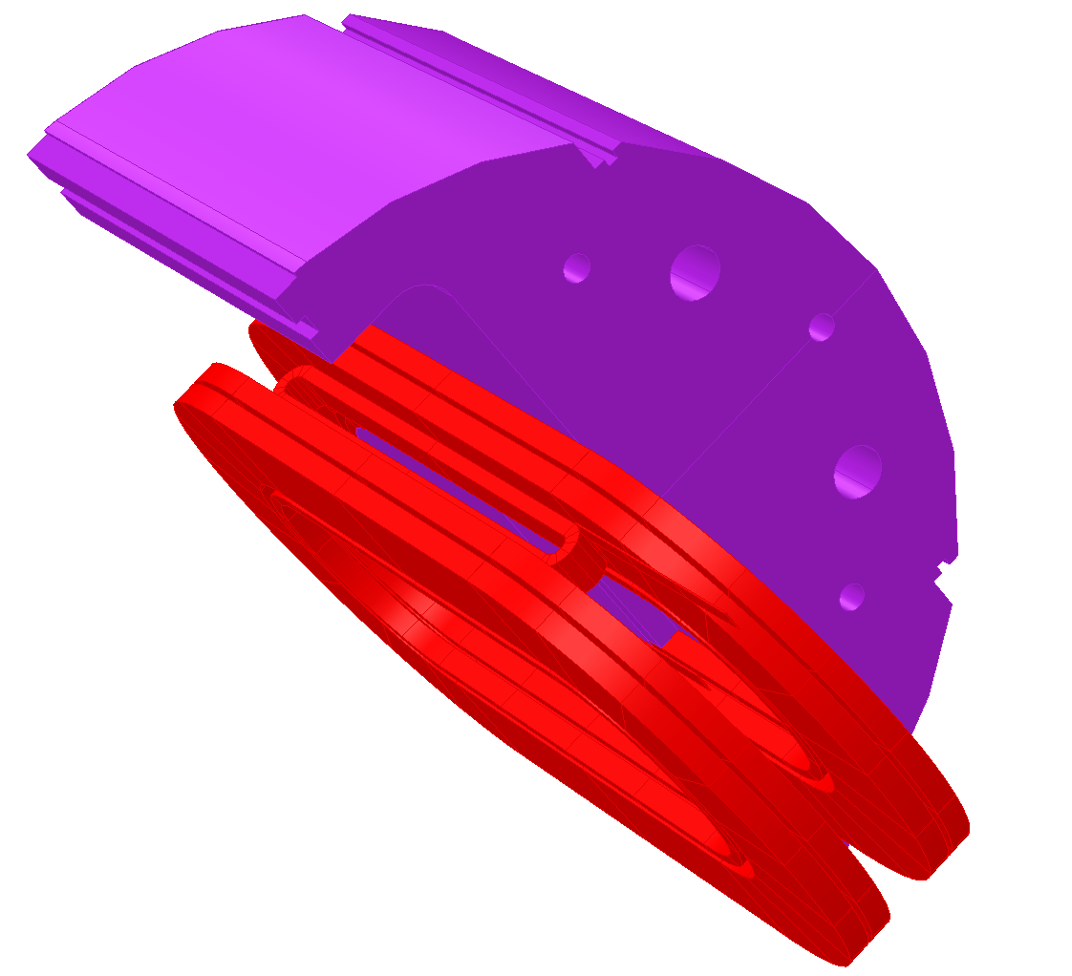

Insert Coil Configuration
This Test (MDP)
Field primarily parallel
Previous Test (SBIR)
Field primarily perpendicular

Slide 29
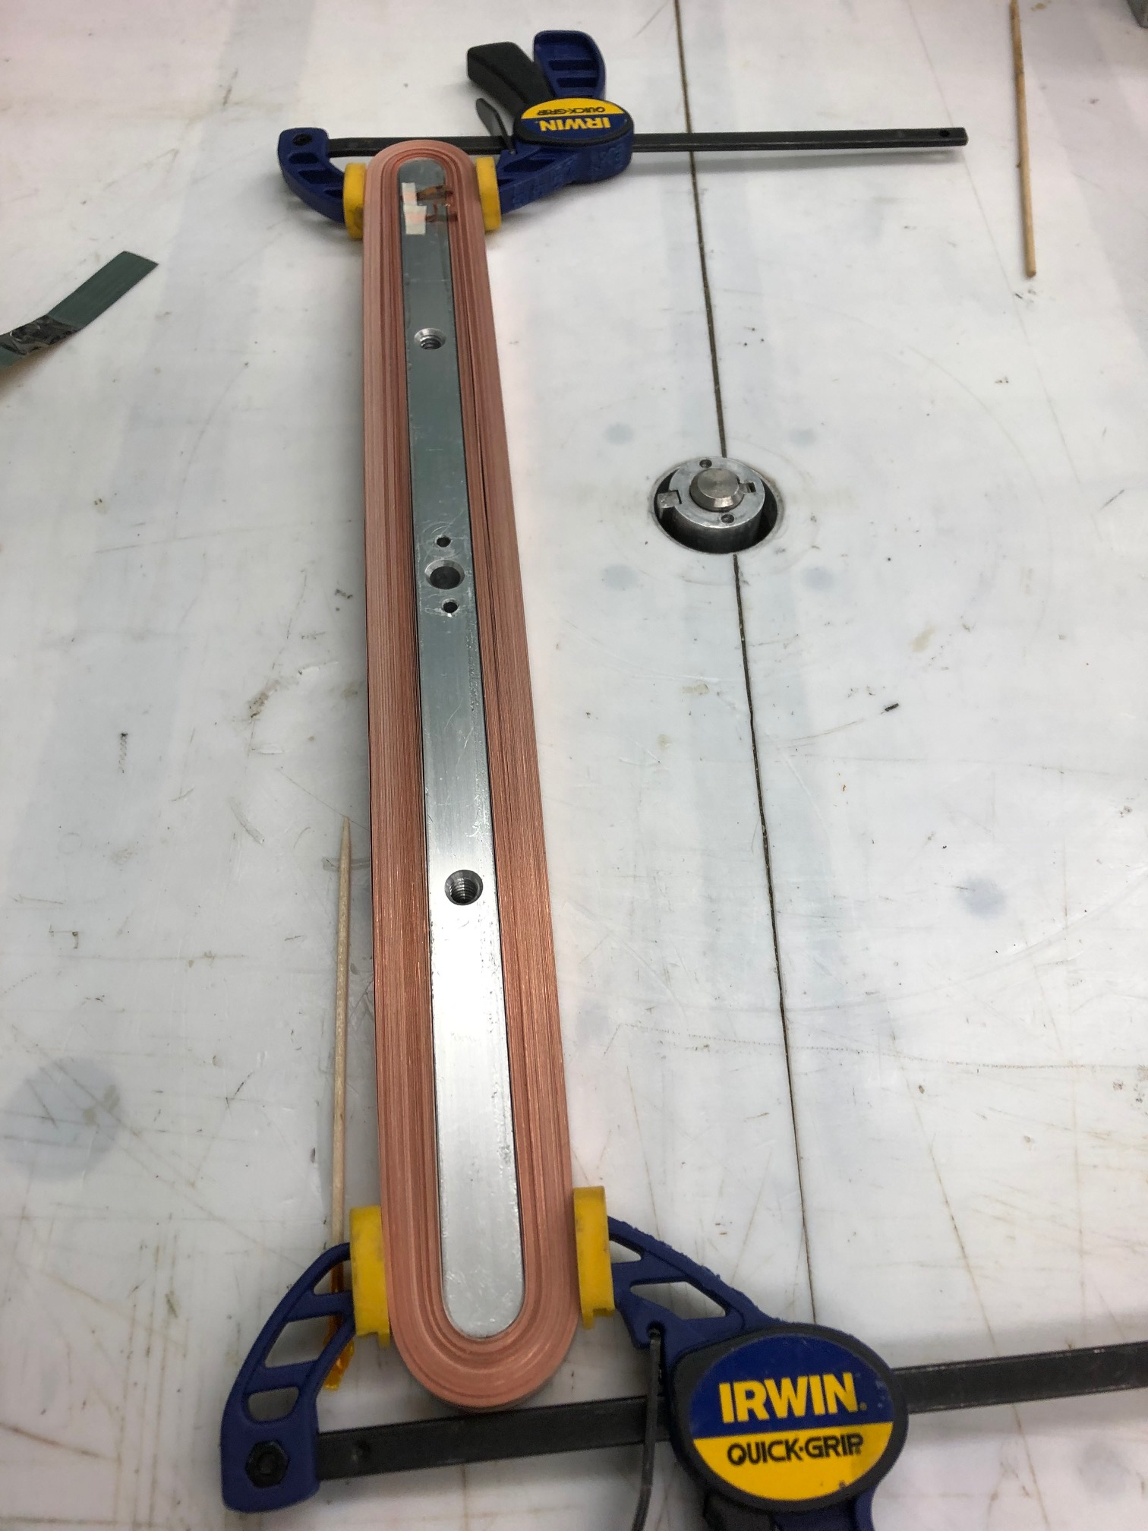
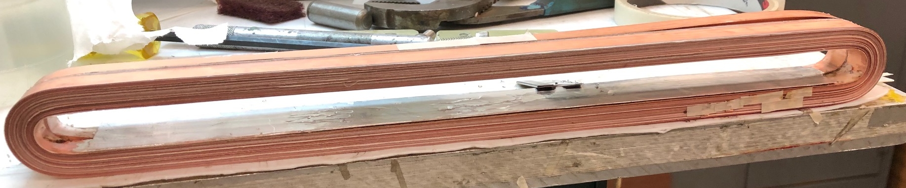
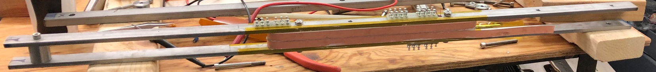
HTS Coils in Different Stages of Construction

Slide 30
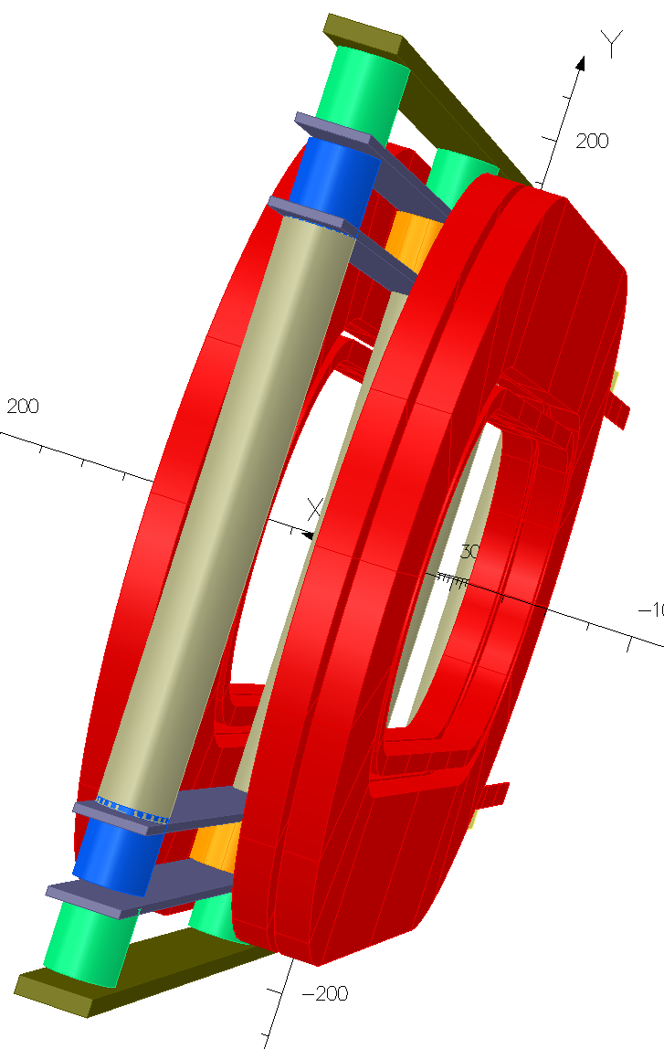
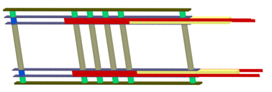

HTS Coil Structure Concept
(two inserted between Nb₃Sn coils)
HTS Insert Coils
3
2
Two double pancake coils in a common frame
1
One double pancake coil in a structure
Single pancake HTS coil wound around bobbin
4
Two coils in two aperture

Slide 31
Other Collaboration

Slide 32

4-turn Double Pancake CORC® Coil in support Structure (to be funded by MDP for quench studies)
Double pancake with current in the 2 pancakes in opposite direction and a gap in between for field measurements and quench diagnostics
Two pancakes in common coil configuration
Conductor Courtesy: Advanced Conductor Technologies LLC
S-turn in transition region changes the direction of the current between the two pancakes.
It should tolerate some horizontal motion (as was the case for the splice during the last test).

Slide 33




Quench Studies on the Stacked Tape Cable for Fusion
Commonwealth Fusion System (CFS) is developing a revolutionary fusion technology based on HTS magnets
It uses Stacked Tape Cable
Funding request from Innovation Network for Fusion Energy (INFUSE) program to perform quench studies in the background field of DCC017
Common coil magnet DCC017 accommodates a large bend radius within the background field of the magnet
Commonwealth Fusion System
https://cfs.energy/

Slide 34
Future US Japan Collaboration
R&D of mineral insulated REBCO coils applying ceramic coating and ceramic bonding technology
Feasibility study →
Racetrack
coil
Courtesy:
Toru Ogitsu,
Masami Ilo
KEK
HTS/LTS hybrid dipole when integrated with DCC017

Slide 35

Texas A&M Proposal
Courtesy:
Peter McIntyre
Texas A&M

Slide 36
Nb₃Sn Coil Block R&D Tests for Understanding the Loss in the Performance of Many Nb₃Sn Magnets
As an another example, one can test a Nb₃Sn coil block (say pole block), reacted and impregnated in 10 T field. It should fit in the available space with appropriate structure.
A series of such simulated tests may help us identify the cause of the loss in the performance of Nb₃Sn magnets.
Perhaps the consequences of not doing such investigative R&D is the large number of Nb₃Sn magnets with poor performance. Result: spending a large sum of money, time and potential loss in the confidence of Nb₃Sn technology.
A systematic, lower cost, faster turn-around focused R&D may allow us to get at the bottom of it.

Slide 37
Future Upgrades
Current setup is for
Insert coil/cable up to 4.5 kA for any background field up to 10 T
Insert coil/cable up 10 kA, if in series with common coil
Future upgrades planned for
Insert coil/cable to 7.5 kA for any background field up to 10 T
Insert coil/cable up to 15 kA, if in series with common coil with added shunt allowing variation in current in insert coil/cable
Transformer inside cryostat allowing up to 100 kA for cable test with any background up to 10 T
Use existing shunt between inner and outer layers of Nb₃Sn coils to push field from 10 T to 11 T

Slide 38
SUMMARY
An alternate approach for performing high field R&D
  Time frame: a few months; Cost: a few hundred k$
It could transform the way we plan and do magnet R&D
BNL dipole DCC017 with large opening is available to facilitate this rapid-turn-around, lower cost R&D
We welcome it’s use and collaboration. Please take advantage of this unique facility to develop and test new technologies or optimize the existing ones

